Slide 1

Kary Well Capstone Project Presentation 卒業論文プレゼンテーション

Slide 2
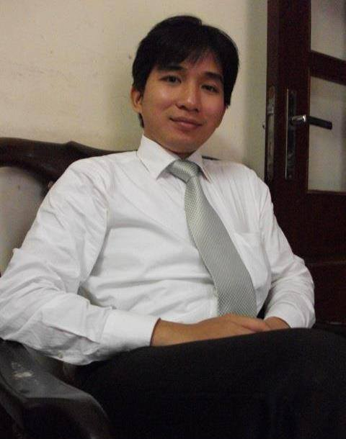




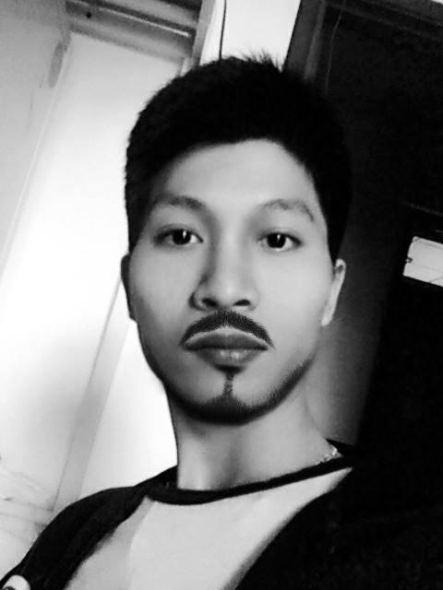

About Us
Supervisor 指導教員 Team member チームメンバー | Lecturer TRAN BINH DUONG LE VAN QUY HOANG – SE90184 TRAN DINH HOANG HUY – SE90201 NGUYEN KHAC HOANG – SE02564 NGUYEN VAN QUYEN - SE02884 KIEU CAO KHANH – SE02960 NGUYEN THI HONG NHUNG – SE02437
HoangLVQ
HuyTDH
HoangNK
QuyenNV
KhanhKC
NhungNTH
1

Slide 3
Outlines -アウトライン
Introduction
導入
II. Project Management
プロジェクト管理
III. Software Requirement Specification
プロジェクト管理
IV. Software Design Description
ソフトウェア要求仕様
V. Quality Control
品質管理
VI. Project Result
プロジェクト結果
VII. Demo
デモ
VIII. Q & A
質問と回答
2

Slide 4
1. Introduce (導入)
Background
Literature review
Proposal
3

Slide 5
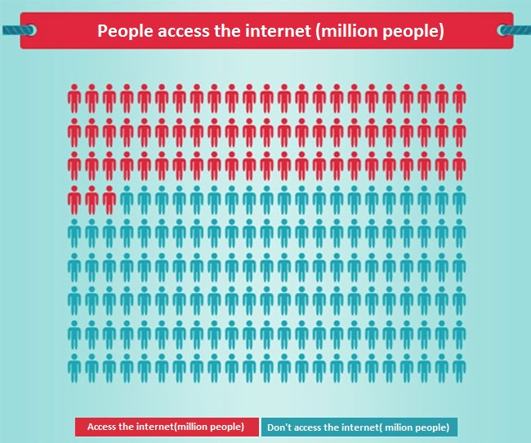
Background
According to the statistics of Vietnam E-Commerce and Information Technology Agency, in 2013 the population of Viet Nam is up to 90 million, in which 36%(31,3 million people) Internet access and more than half of this is shopping online
4

Slide 6
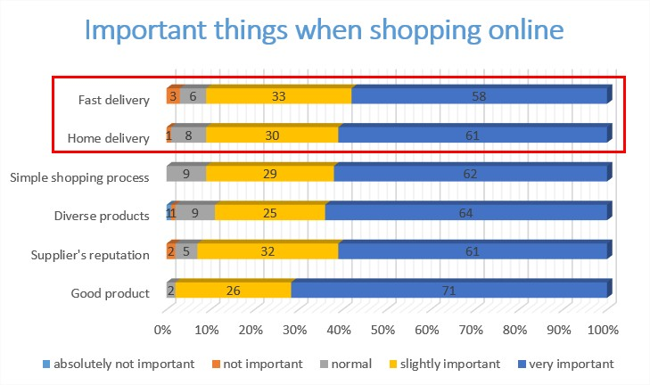
Background
61% of people said that home delivery is very important when shopping online.
58% said that fast delivery is very important.
5

Slide 7
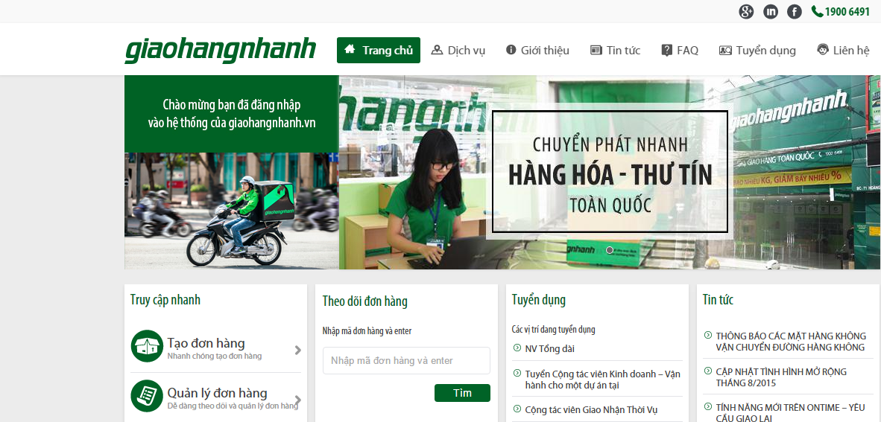
Literature review
Giaohangnhanh.vn
Pros:
Well know brand image in Vietnam
Having many shippers, system can receive lots of orders
Low price
Cons:
Track order function is not well interface, just use text to display status (Wait, Shipper is comming, Shipping, Done)
Don’t have express delivery service.
Don’t have mobile app for shipper to find the way.
6

Slide 8
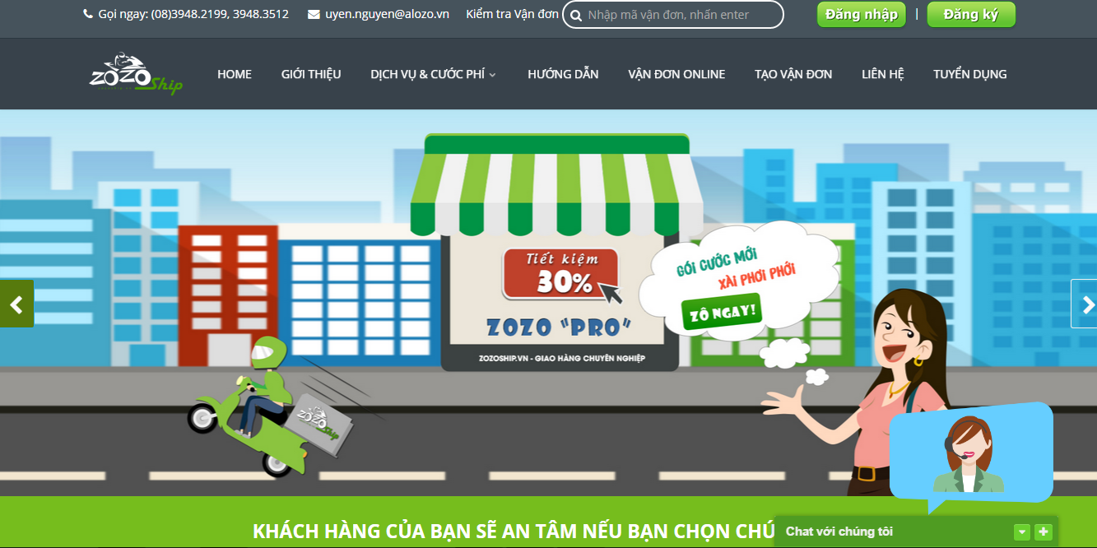
Literature review
Zozoship.vn
Pros:
Track order status on website
Many service pack with clearly information
Nationwide delivery
Goods insurance
Cons:
Working are: only Ho Chi Minh city
Don’t apply technology to immediately find the nearest shipper to the order.
Track order function is not well interface, just use text to display status
7

Slide 9
Proposal
We’ll develop a system that include 4 part:
Part 1: Web application for store that support store’s employee everything they need to create an order, verify shipper who come to takes goods. Store also knows location of shipper (goods) on maps.
Part 2: Mobile-application for shipper that support shipper view information of order,. Beside, shipper can notify to system if have issue while delivering.
Part 3: Web application for admin that help system managers manage shipper, store, transaction history and know about issue of delivery process.
Part 4: Web service that save all information of store, shipper and transaction history.
8

Slide 10
2. Project Mangement (プロジェクト管理)
2.1. Software Process Model
ソフトウェ アプロセス モデル
2.2.Project Organization
プロジェクト組織
2.3. Project Schedule
プロジェクト計画
2.4. Objectives & deliverables
目標 と 成果物
2.5. Tools & Infrastructure
ツールと インフラストラクチャ
2.6. Risks management
リスク管理
2.7. Configuration management
コンフィグレーション管理
2.8. Communication management
コミュニケーション管理
9

Slide 11
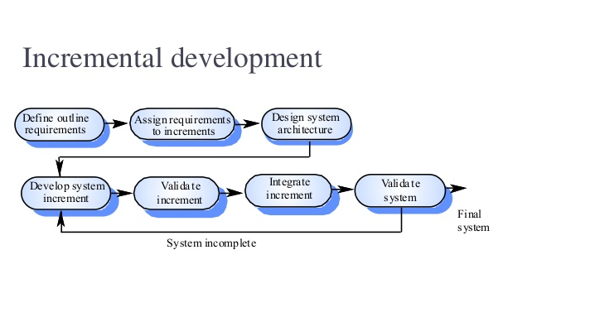
2.1 Software Process Model - ソフトウェアプロセスモデル
Some main functions can be developed early & quickly
More flexible - Easy & less costly to change if having.
Testing and debugging during smaller iteration is easy
Iterations may be run simultaneously. A design team starts the next iteration while the current one is under test
The project team learns from first iterations and may use best practices and experiences in next iterations
Easier to manage risk because risky pieces are identified and handled during its iteration.
10

Slide 12
2.2 Project Organization - プロジェクト組織
Tran Binh Duong
Supervisor
Le Van Quy Hoang
PM
Nguyen Khac Hoang
Technical Leader
Nguyen Thi Hong Nhung
Test Leader/QA
Tran Dinh Hoang Huy
Developer
Nguyen Van Quyen
Developer
Kieu Cao Khanh
Developer
Le Van Quy Hoang
Developer
11

Slide 13
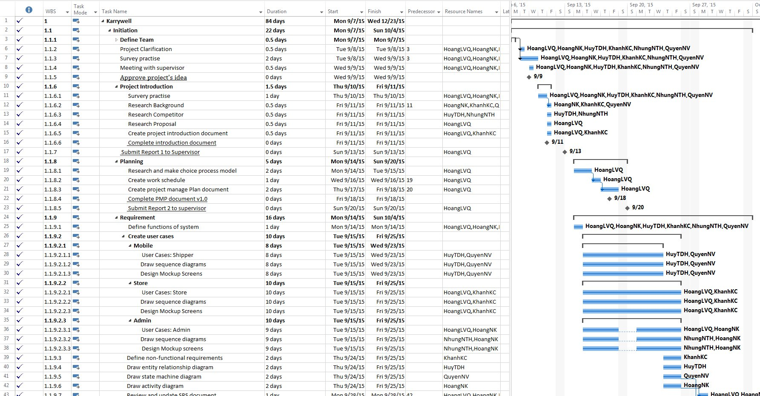
2.3 Project Schedule - プロジェクト計画
12

Slide 14
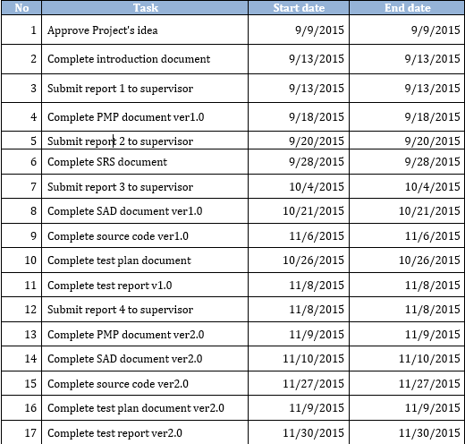
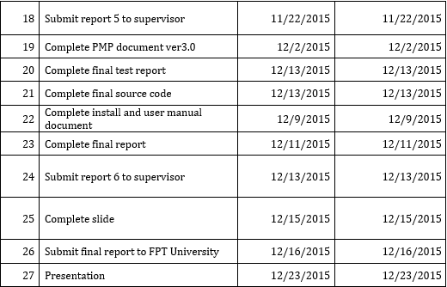
2.4 Milestones & deliverables - マイルストーンズと成果物
13

Slide 15
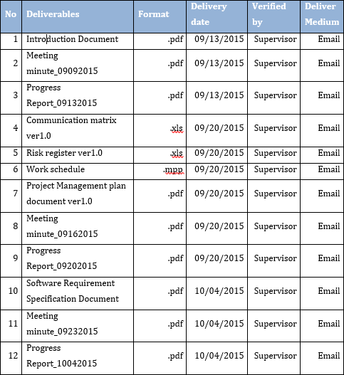
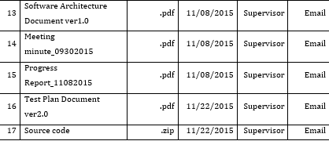
2.4 Milestones & deliverables - マイルストーンズと成果物
14

Slide 16










2.5 Tools & Infrastructure - ツールと インフラストラクチャ
Tools
Tools for project management
SourceTree
Word 2013
Excel 2013
Project 2013
Power Point 2013
Tools for developing
WebStorm
pgAdmin
Google Chrome
Firefox
Astah
15

Slide 17
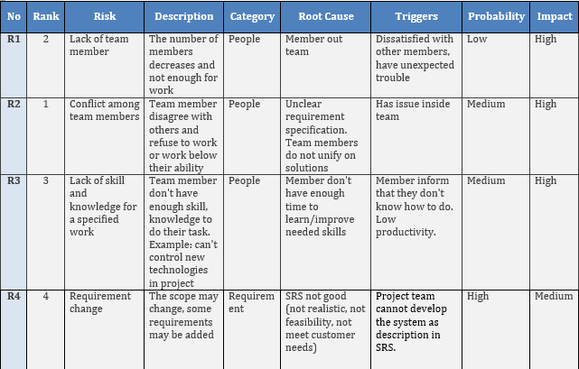
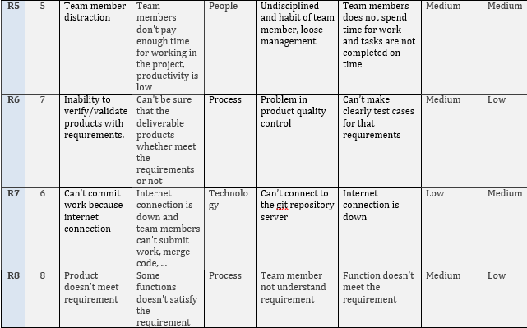
2.6. Risks management -リスク管理
16

Slide 18
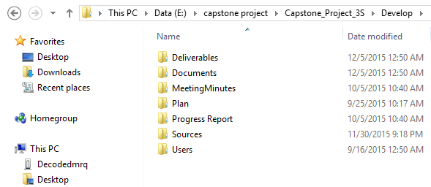
2.7 Configuration management - コンフィグレーション管理
Deliverables: Store deliverable document
Documents: Store documents of project
MeetingMinutes: Store meeting minutes of project
Plan: Store plan of project
Progress Report: Store report of project
Sources: Store source code of project
Users: Store any file of each member in project
Folder structure of project
17

Slide 19
3. Software Requirement (Specification -プロジェクト管理)
3.1. Business Process -ビジネスプロセ
3.2 Functional Requirements - 機能要求
3.3 Non-functional Requirements - 非機能要求
18

Slide 20
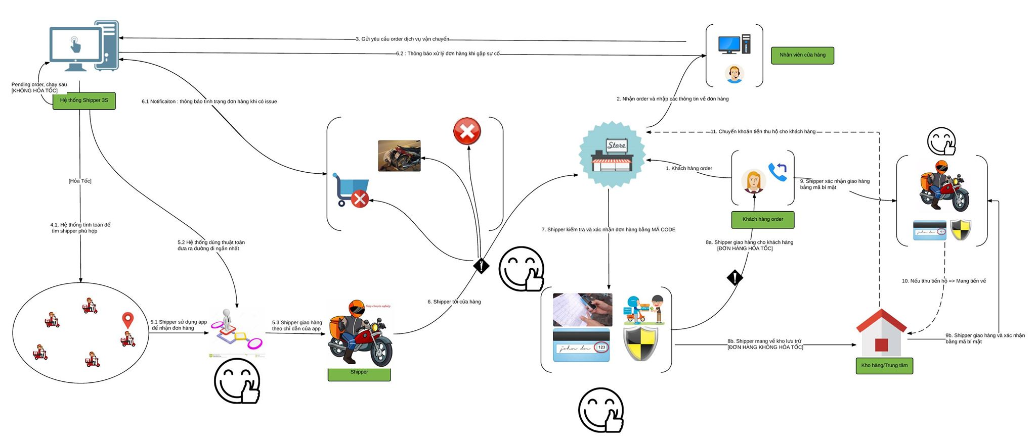
3.1. Business Process -ビジネスプロセ
Actor:
Business rich picture of system
19

Slide 21



3.1. Business Process -ビジネスプロセ
Actor:
Admin
Shipper
Store
19

Slide 22
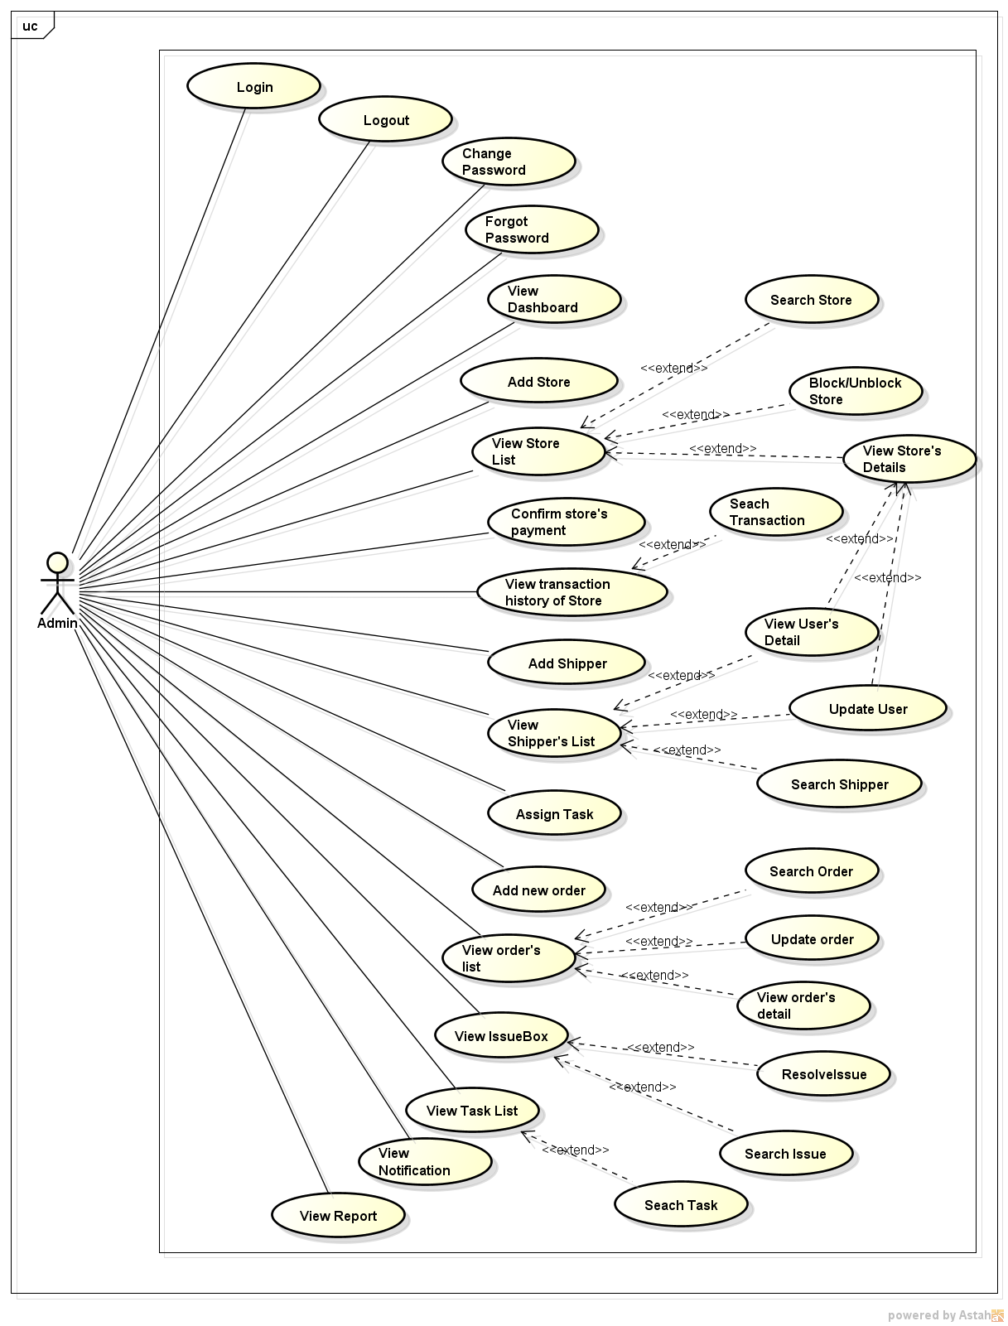
3.2. Functional Requirements - 機能要求
User use case diagram for Admin
20

Slide 23
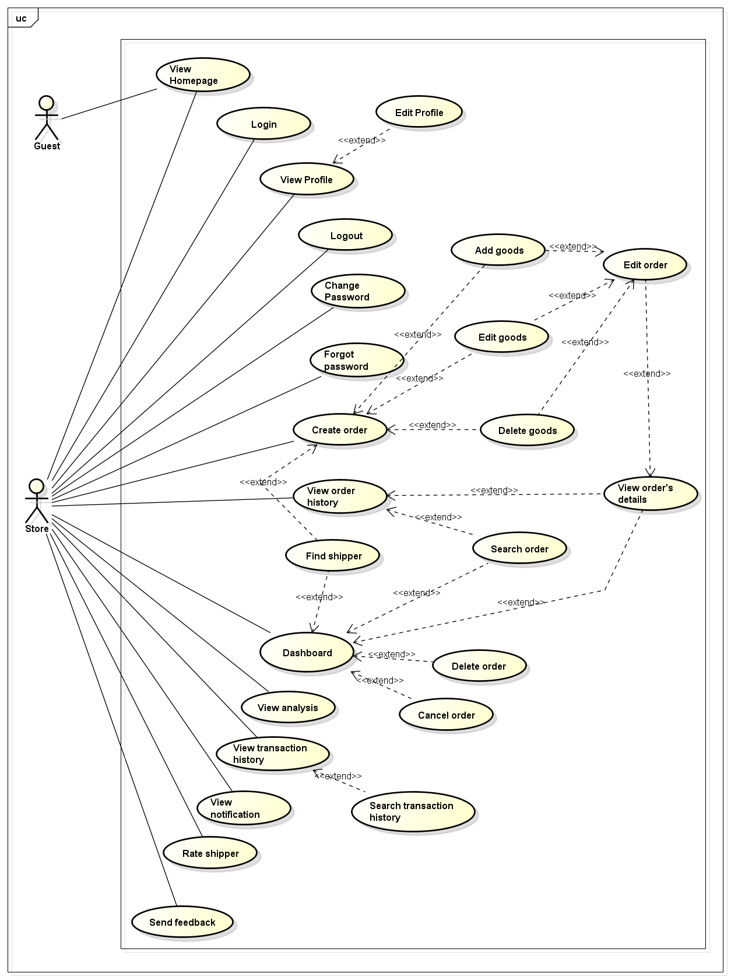
3.2. Functional Requirements - 機能要求
User use case diagram for Store
21

Slide 24
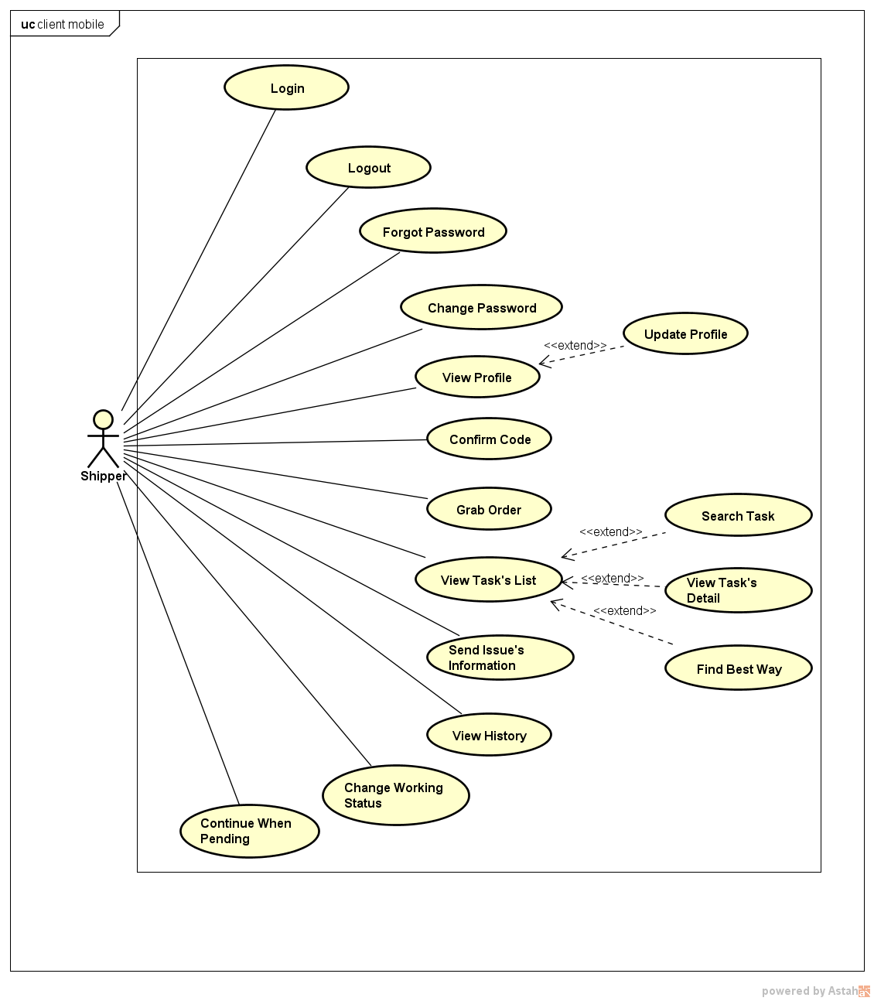
3.2. Functional Requirements - 機能要求
User use case diagram for Shipper
22

Slide 25
3.3. Non - Functional Requirements - 機能要求
Usability
- User interface should be clear and easy to use.
- User can complete each function in less than 10 actions
Performance
- System could support a large number of users at the same time.
Other functions of system perform normal while have many order running on application
Maintainability
Application is easily to maintain without any crashes
23

Slide 26
3.3. Non - Functional Requirements - 機能要求
Scalability
The system is easy to extend and add new feature.
Availability
The application is available 24/7.
Security
- Information of user on server is secured.
- With store, order is ensured that execute exactly and in time.
24

Slide 27
4. Software Design (ソフトウェア設計)
4.1.Architectural Representation
アーキテクチャ表現
4.2. Technology and Reason
テクノロジーと理由
4.3. Database Design
データベース設計
4.4. Class Diagram
クラス図
4.5. Sequence Diagram
シーケンス図
4.6. Screen Design
画面の設計
25

Slide 28
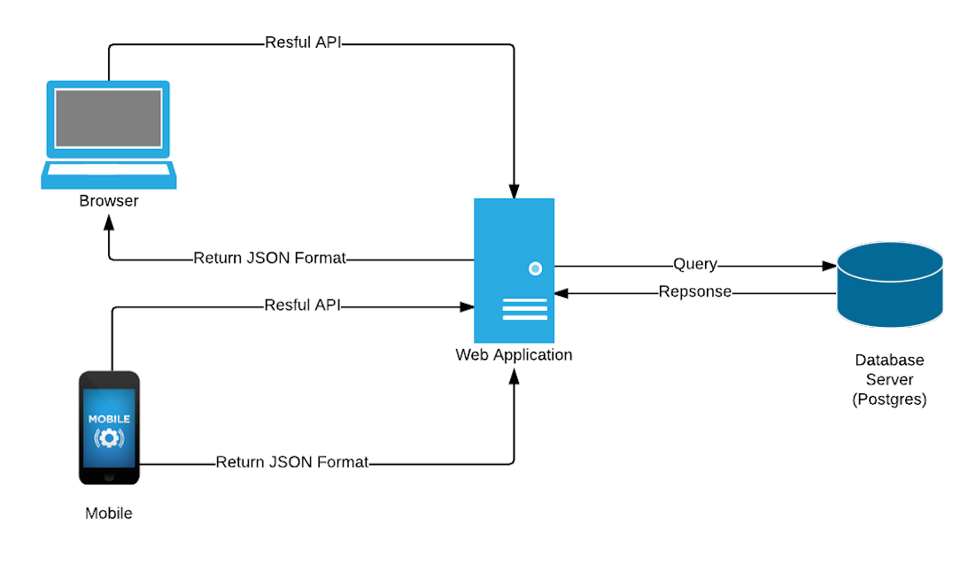
4.1. Architectural Representation - アーキテクチャ表現
Overview of Karywell system
28

Slide 29
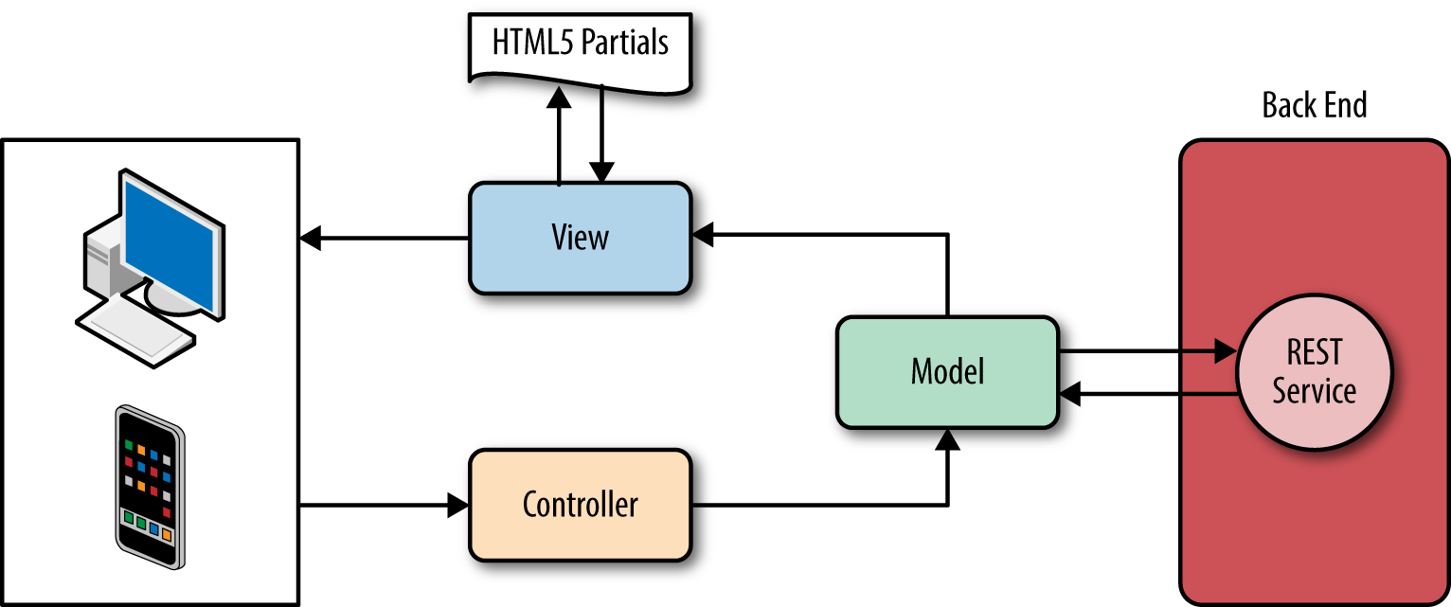
4.2. Technology and Reason -テクノロジーと理由
Mobile application
Because we want to create an application that build once but run on many platform mobile (IOS, Android...). Therefore we choose the IONIC framework to create a hybrid application. This framework uses Angular which allows us easy to develop application following MVC model.
26

Slide 30
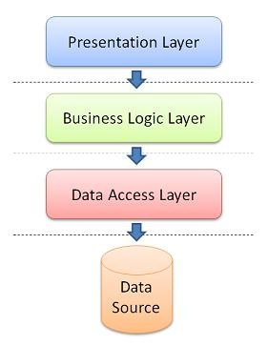
4.2. Technology and Reason -テクノロジーと理由
Web application : N-layers model
The benefits of N-layer model:
Other applications will be able to reuse the functionality exposed by layers
The maintenance of application is easier because of the low coupling between layers.
It's easy to distribute layers over multiple physical tiers. This can make a very good impact on application by improving performance (sometimes), scalability and fault tolerance.
Layers make your application more testable.
27

Slide 31
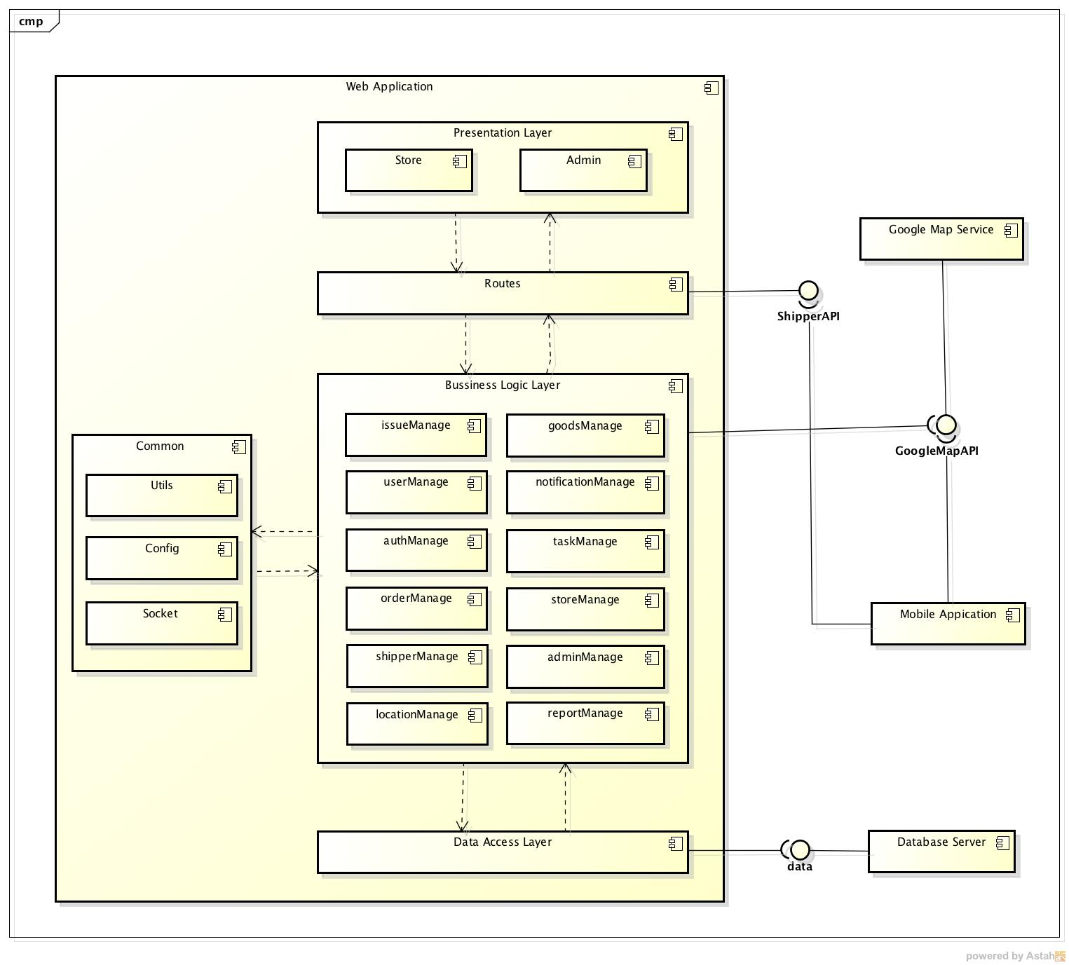
4.2. Architectural Representation - アーキテクチャ表現
Component Diagram
29

Slide 32
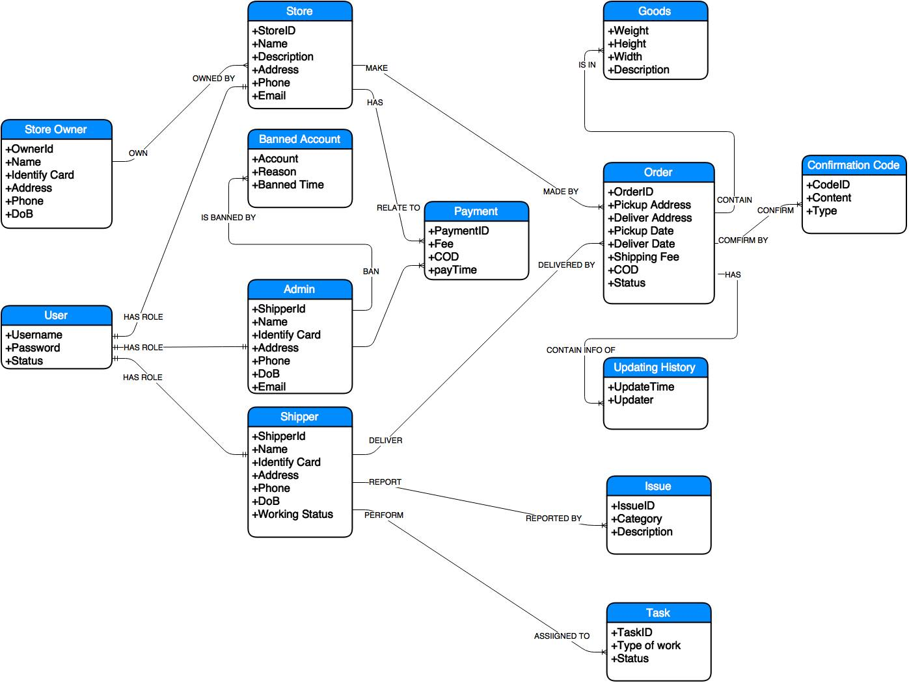
4.3. Database Design - データベース設計
Entity Relationship Diagram
30

Slide 33
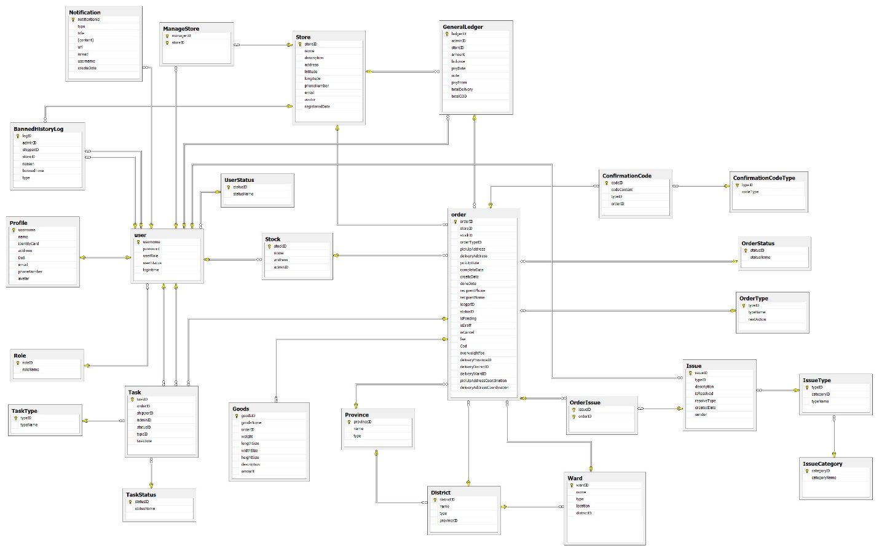
4.3. Database Design - データベース設計
Entity Relationship Diagram
30

Slide 34
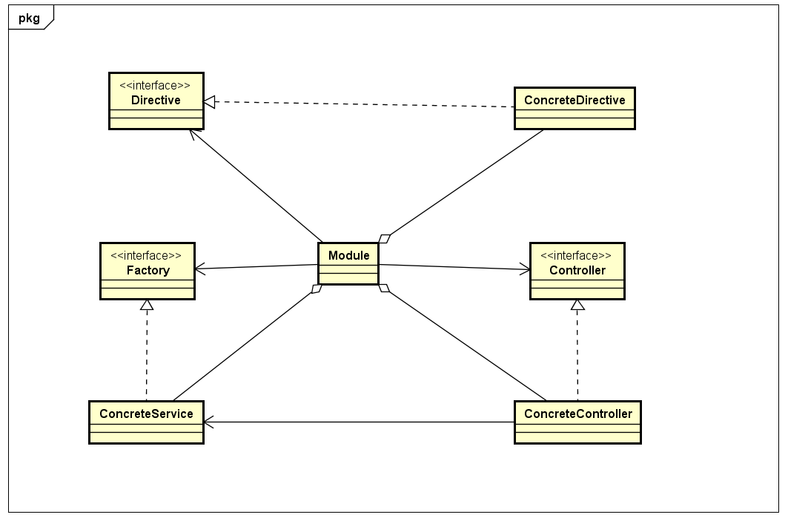
4.4. Class Diagram - クラス図
Class Diagram of Angular Module
36

Slide 35
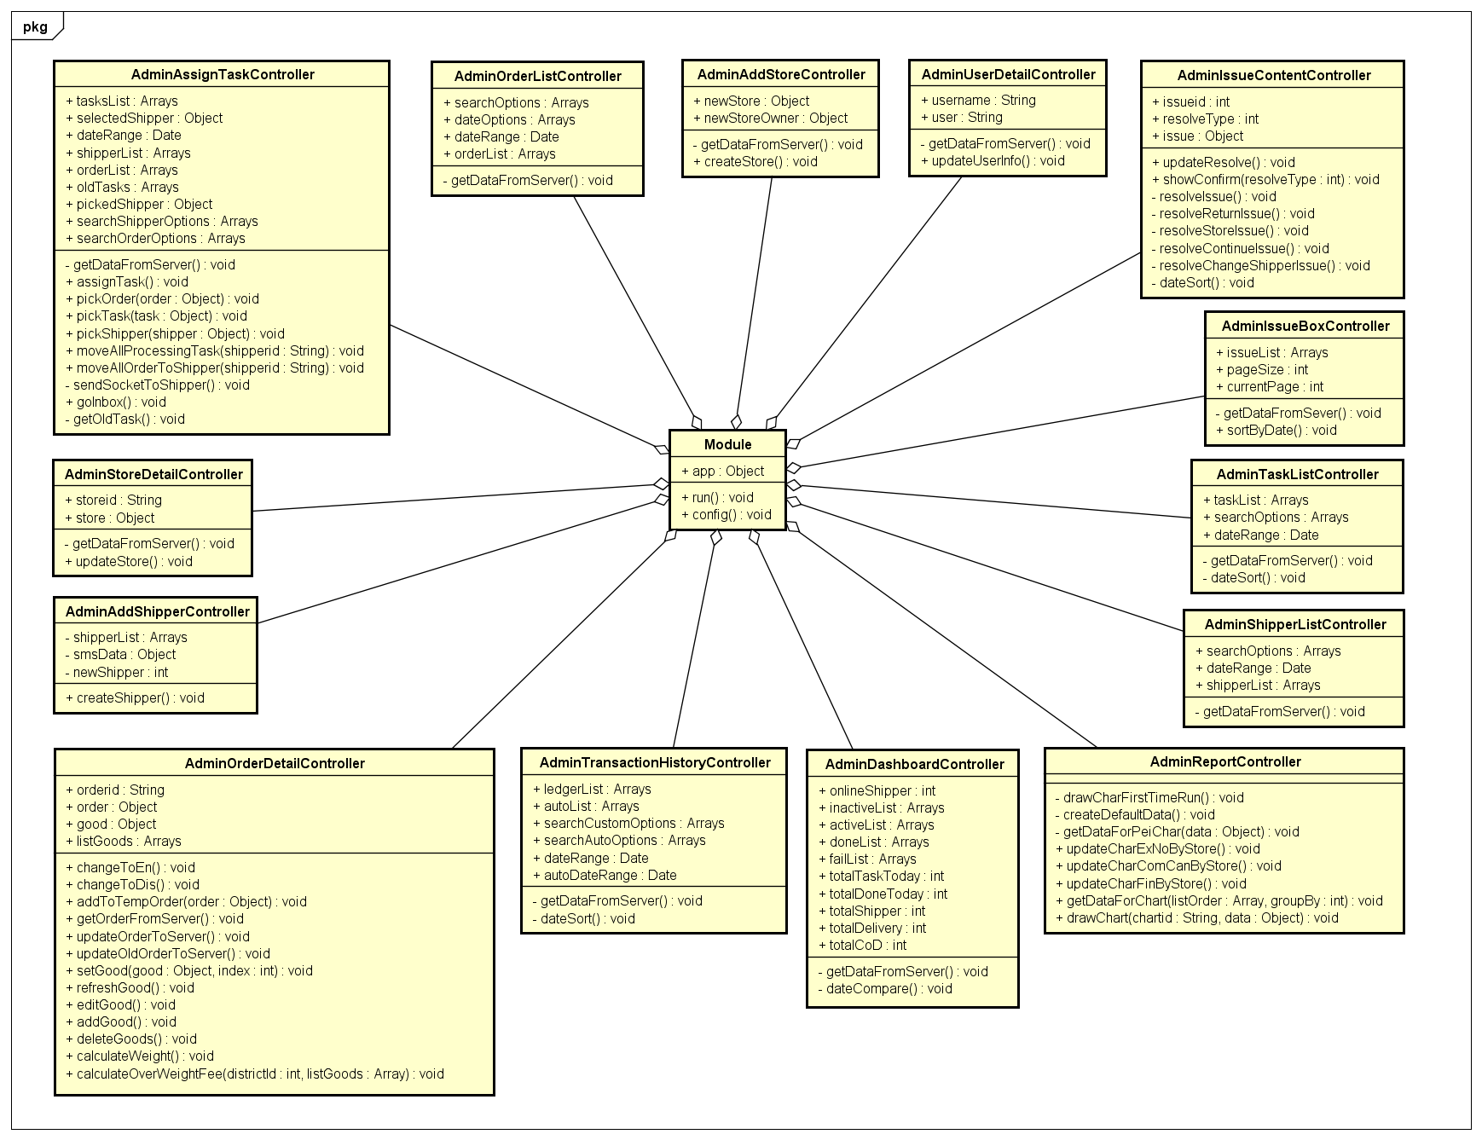
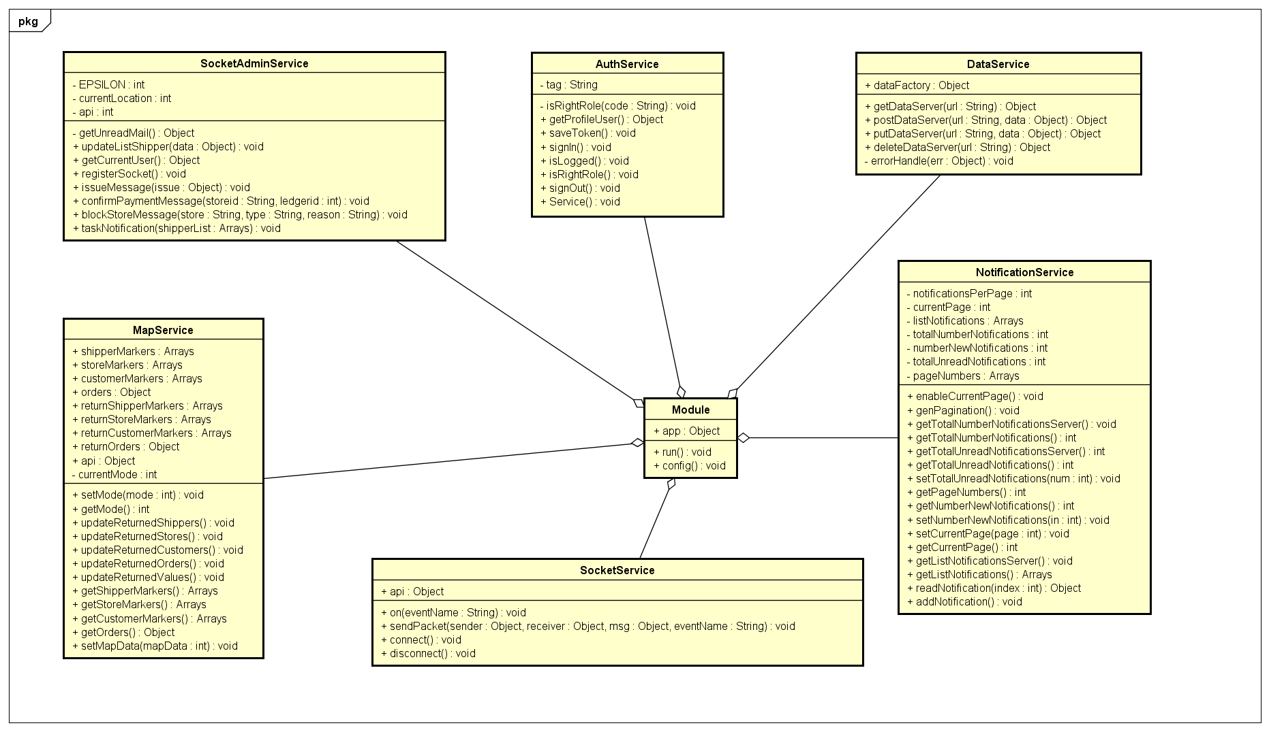
4.4. Class Diagram - クラス図
Class Diagram of Controller for Admin
Class Diagram of Service for Admin
37

Slide 36
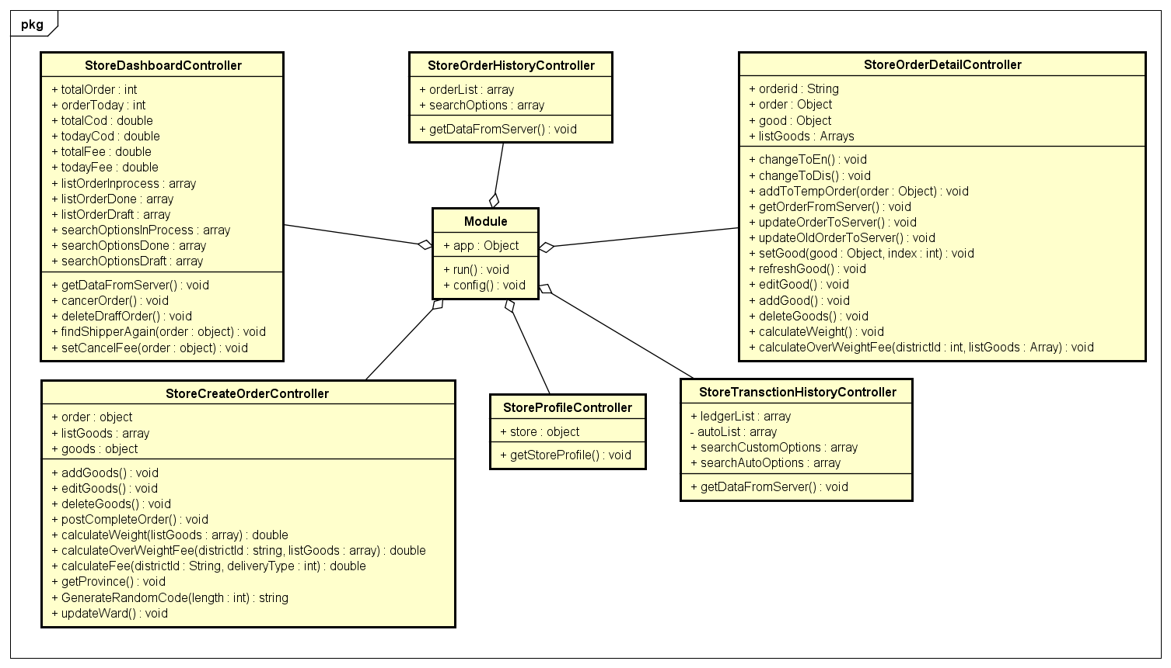
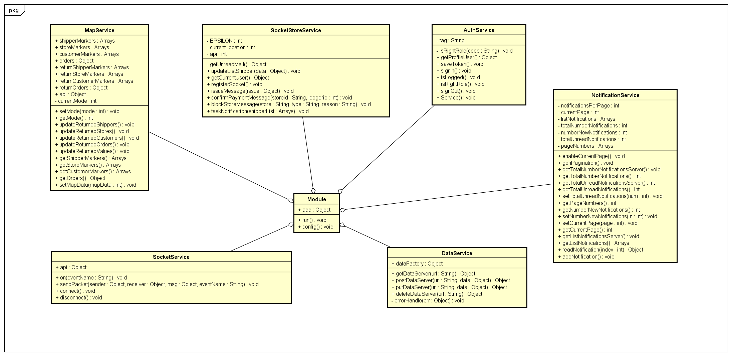
4.4. Class Diagram - クラス図
Class Diagram of Controller for Store
Class Diagram of Service for Store
38

Slide 37
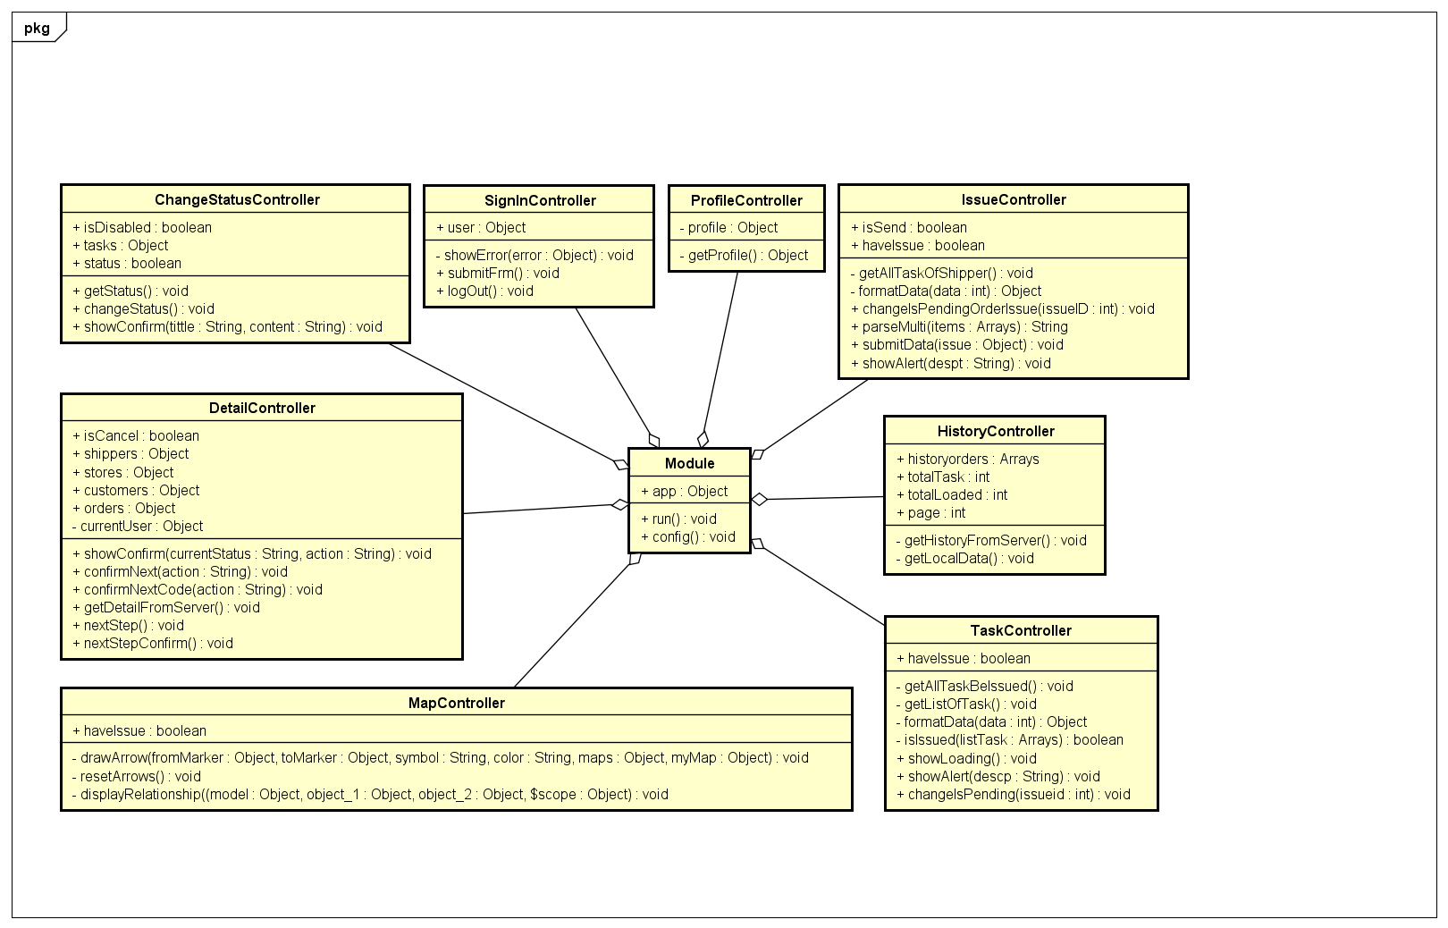
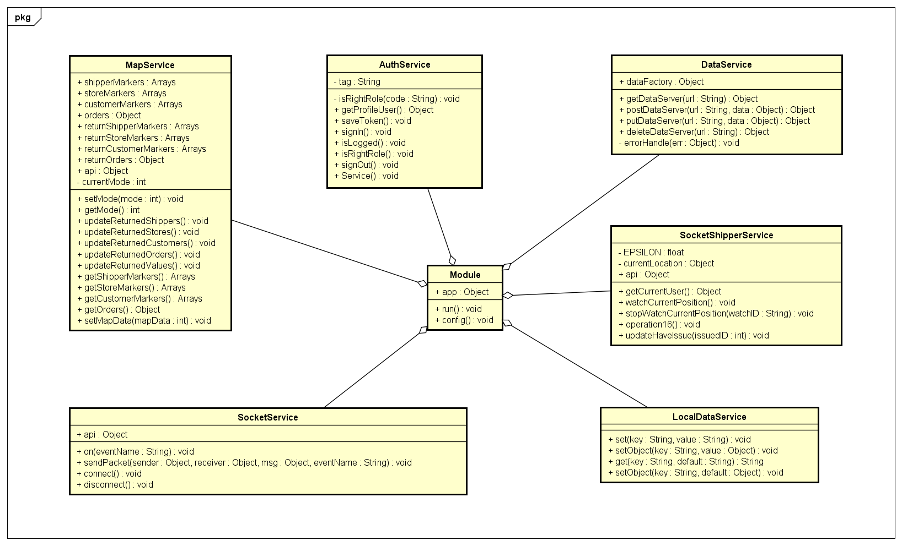
4.5. Class Diagram - クラス図
Class Diagram of Controller for Shipper
Class Diagram of Service for Shipper
39

Slide 38
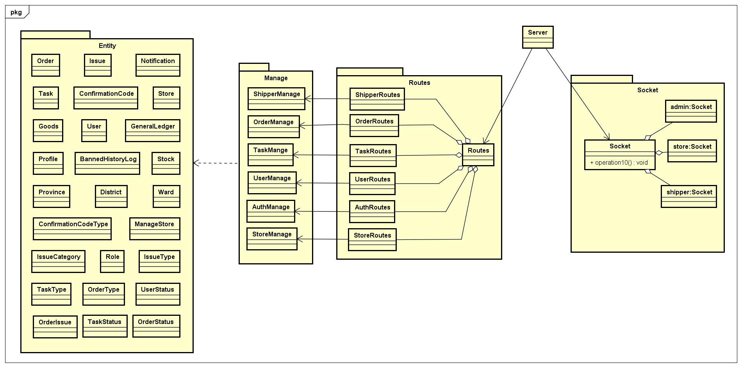
4.4. Class Diagram - クラス図
Class Diagram of Server
40

Slide 39
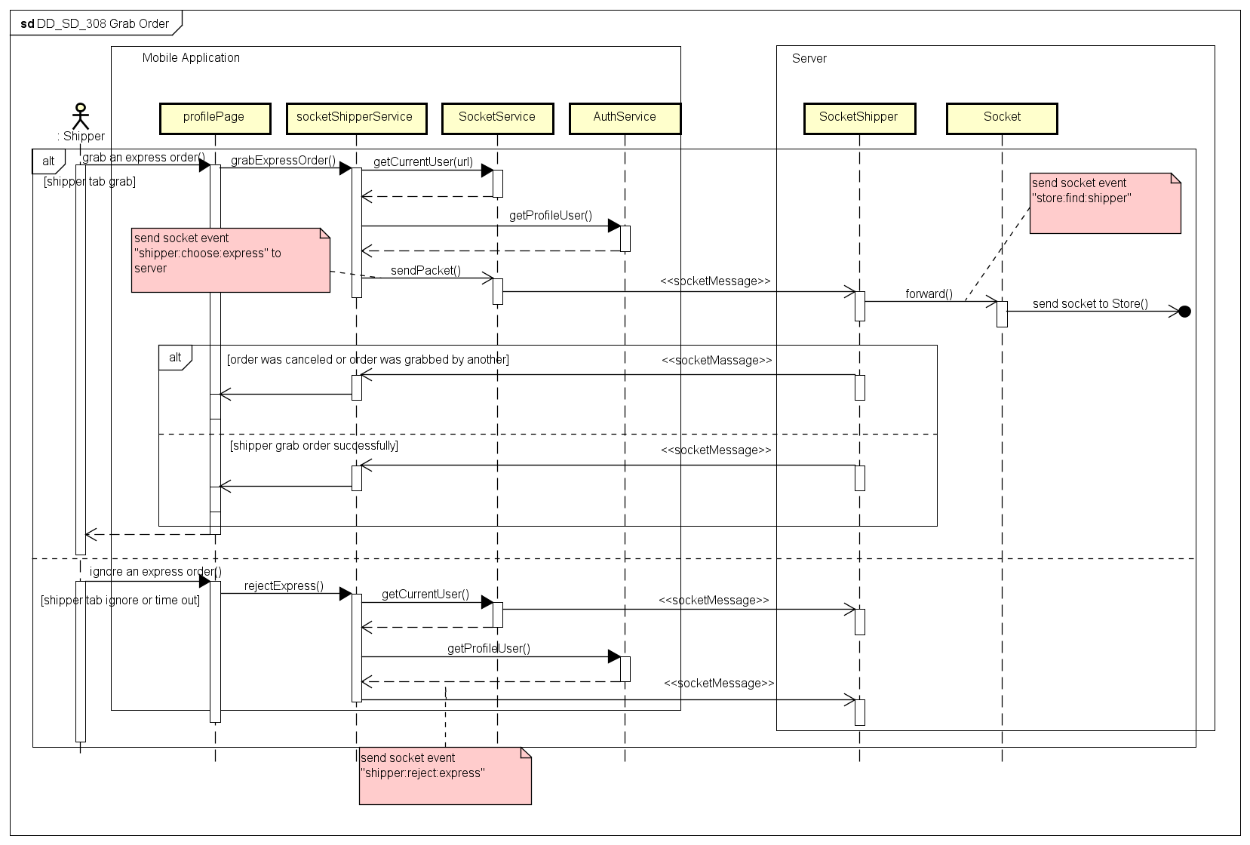
4.5. Sequence Diagram - シーケンス図
Sequence Diagram of Grab Order use case
40

Slide 40
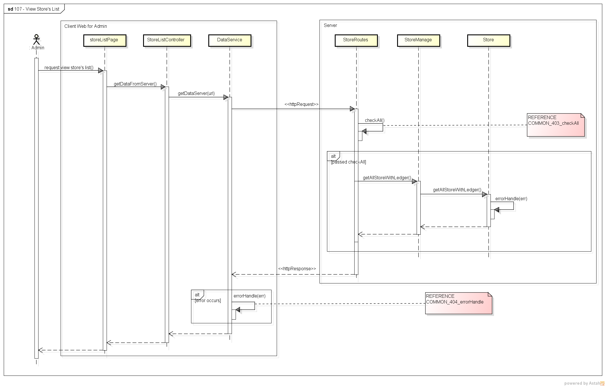
4.5. Sequence Diagram - シーケンス図
Sequence Diagram of View Store’s List use case
40

Slide 41
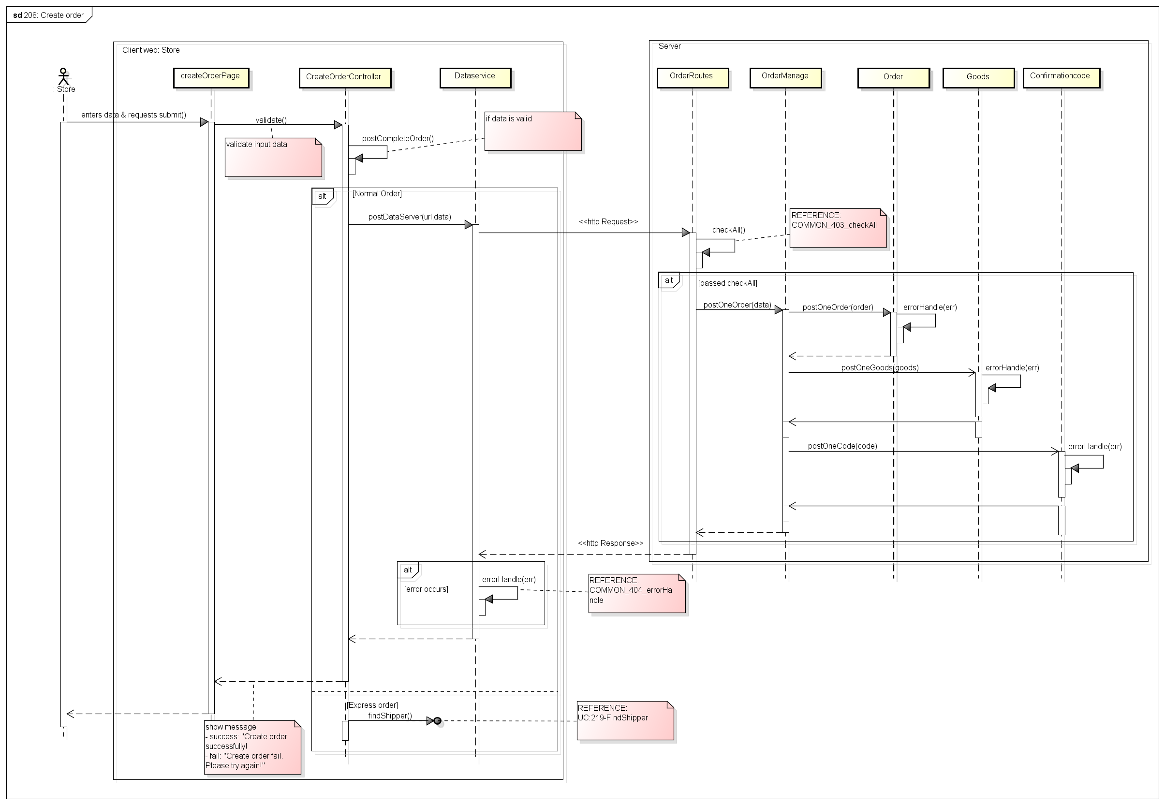
4.5. Sequence Diagram - シーケンス図
Sequence Diagram of Create Order use case
40

Slide 42
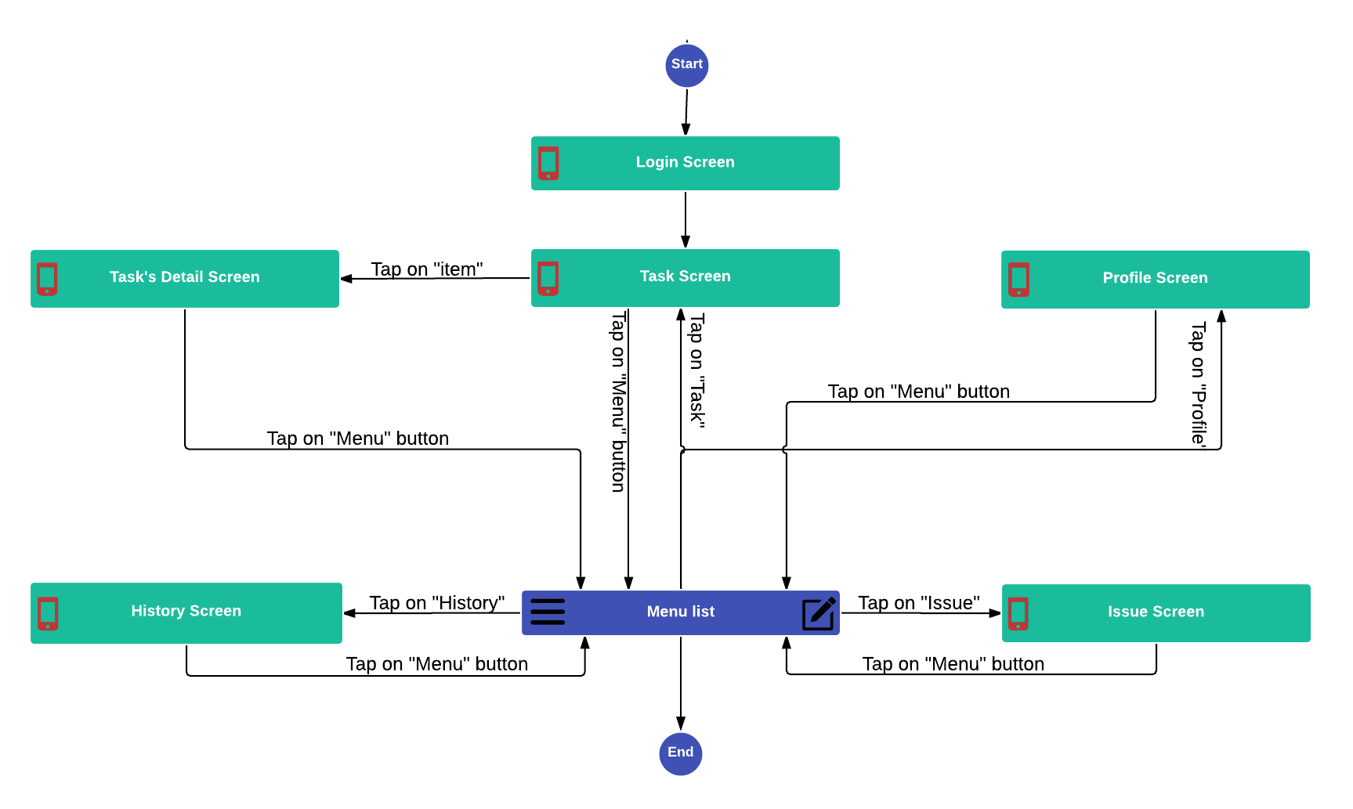
4.6. Screen Design- 画面の設計
4.6.1. Screen Flow - 画面の流れ
Mobile Screen Flow
31

Slide 43
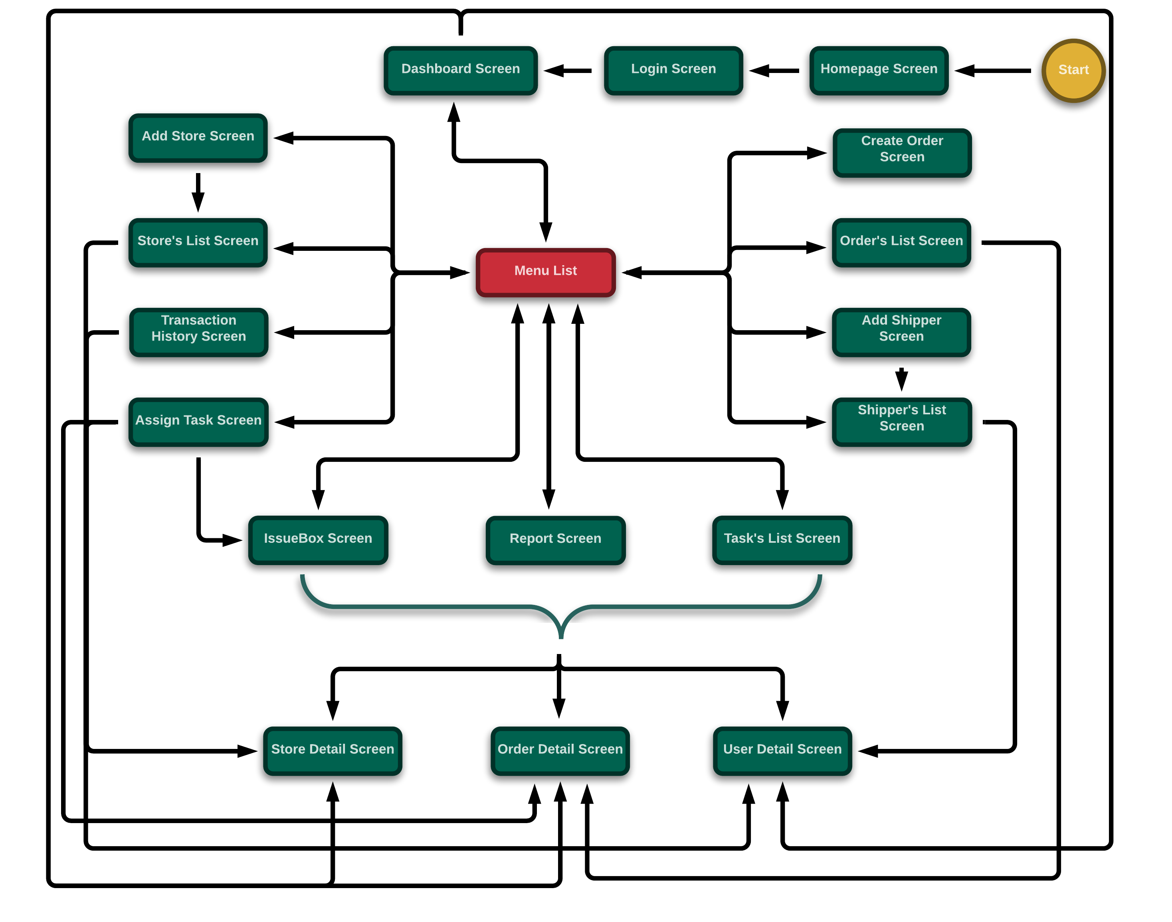
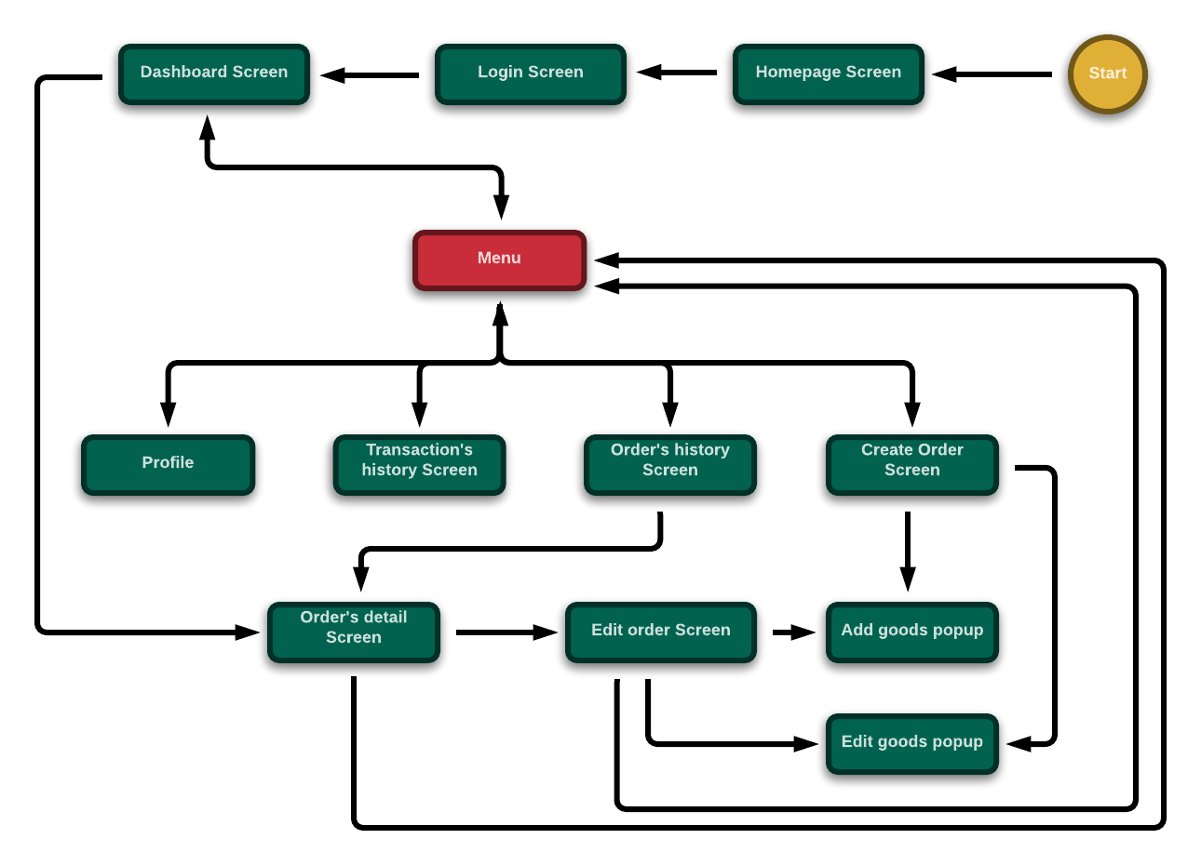
4.6. Screen Design- 画面の設計
4.6.1. Screen Flow - 画面の流れ
Client-web for Admin Screen Flow
Client-web for Admin Screen Flow
32

Slide 44
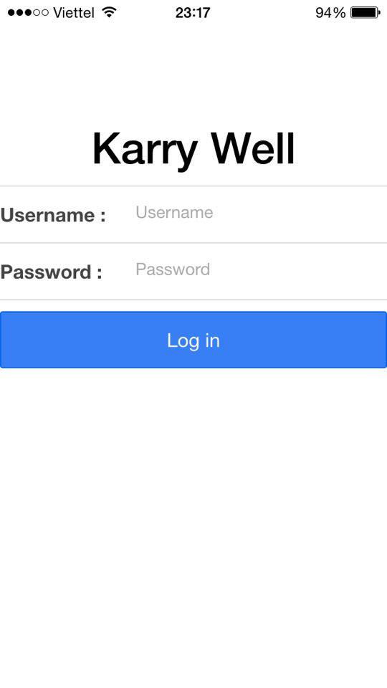
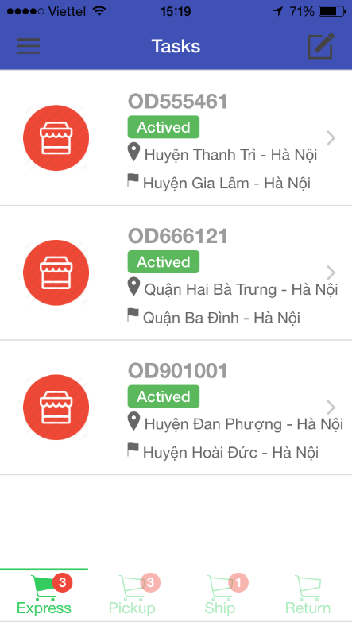
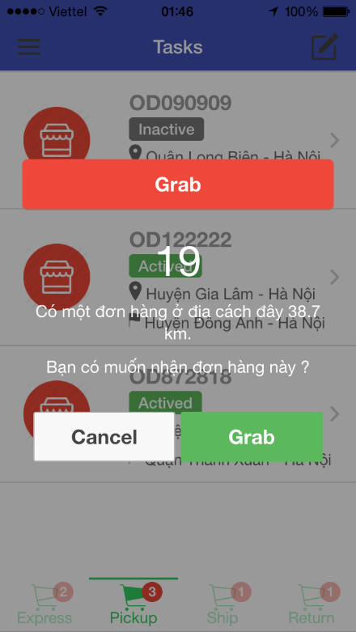
4.6. Screen Design- 画面の設計
4.6.2. Screen Design - 画面の設計
Screen of Mobile Application
33

Slide 45
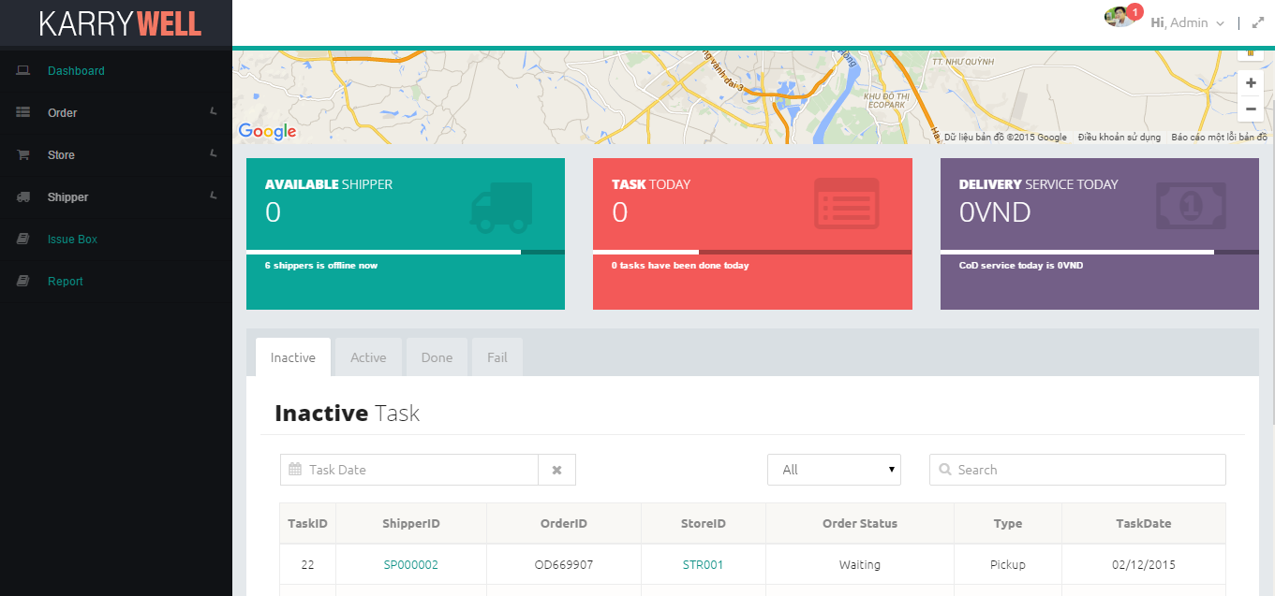
4.6. Screen Design- 画面の設計
4.6.2. Screen Design - 画面の設計
Screen of Client-Web for Admin
34

Slide 46
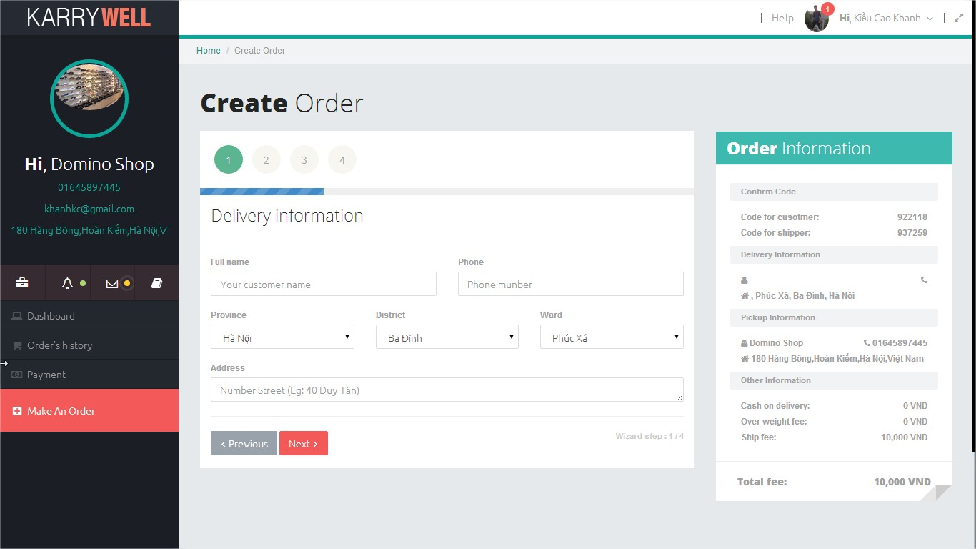
4.6. Screen Design- 画面の設計
4.6.2. Screen Design - 画面の設計
Screen of Client-Web for Store
35

Slide 47
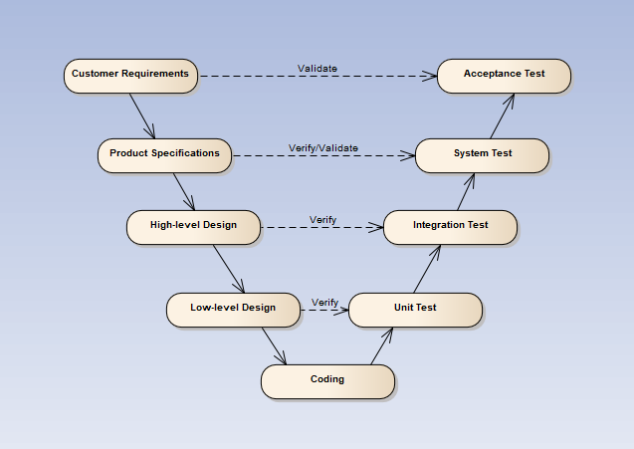
5. Quality Control - 品質管理
V-model process
41

Slide 48
5. Quality Control (品質管理)
5.1 Test Process
5.2 Test Report
42

Slide 49
5.1 Test Process -テストのプス
1
Create Test Plan
2
7
3
4
5
6
Create Test Case
Review Test Case
Execute Test
Log Bug
Re-test
Create Test Report
Base on Project Plan, Project Schedule , SRS to create test plan:
Features to be tested
Acceptance Test Criteria
Environment
Schedules
Responsibilities
Risks and contingencies
…
43

Slide 50
5.1 Test Process -テストのプス
Acceptance test criteria:
Statement coverage: 100%
Branch coverage: 100%
Path coverage: 100%
Test Approach:
Unit Test: Developer
Integration Test: Tester
System Test: Tester
Acceptance Test: Customer
Test Environment:
Web :Chrome 40 or above
Firefox 80 or above
1
Create Test Plan
2
7
3
4
5
6
Create Test Case
Review Test Case
Execute Test
Log Bug
Re-test
Create Test Report
44

Slide 51
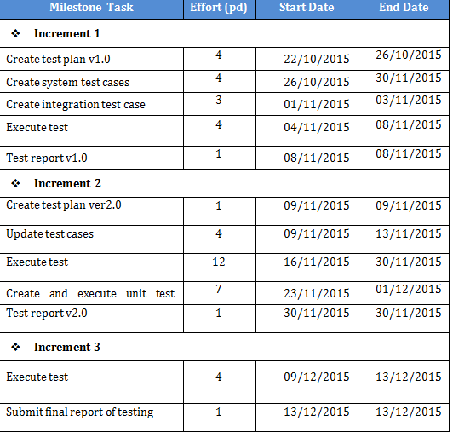
5.1 Test Process -テストのプス
1
Create Test Plan
2
7
3
4
5
6
Create Test Case
Review Test Case
Execute Test
Log Bug
Re-test
Create Test Report
45

Slide 52
5.1 Test Process -テストのプス
Base on SRS, create test case:
Unit test case
Integration test case
System test case
Acceptance test case
1
Create Test Plan
2
7
3
4
5
6
Create Test Case
Review Test Case
Execute Test
Log Bug
Re-test
Create Test Report
46

Slide 53
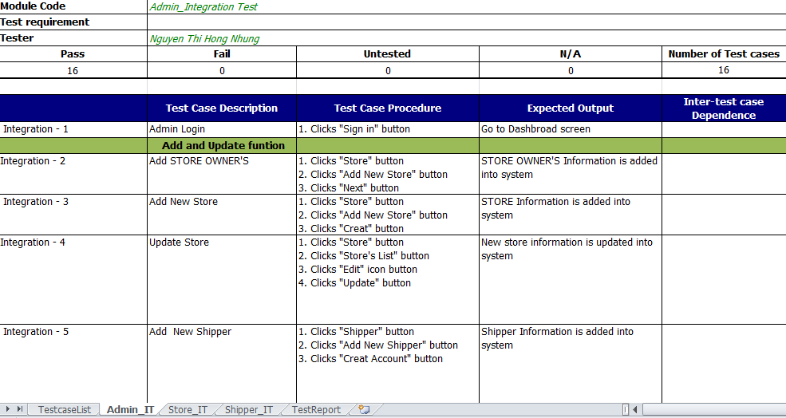
Integration test case コンポーネントのテストケース
47

Slide 54
5.1 Test Process -テストのプロセス
1
Create Test Plan
2
7
3
4
5
6
Create Test Case
Review Test Case
Execute Test
Log Bug
Re-test
Create Test Report
Developer self-review:
Unit test case
Tester self-review and peer-review:
Integration test case
System test case
48
56

Slide 55
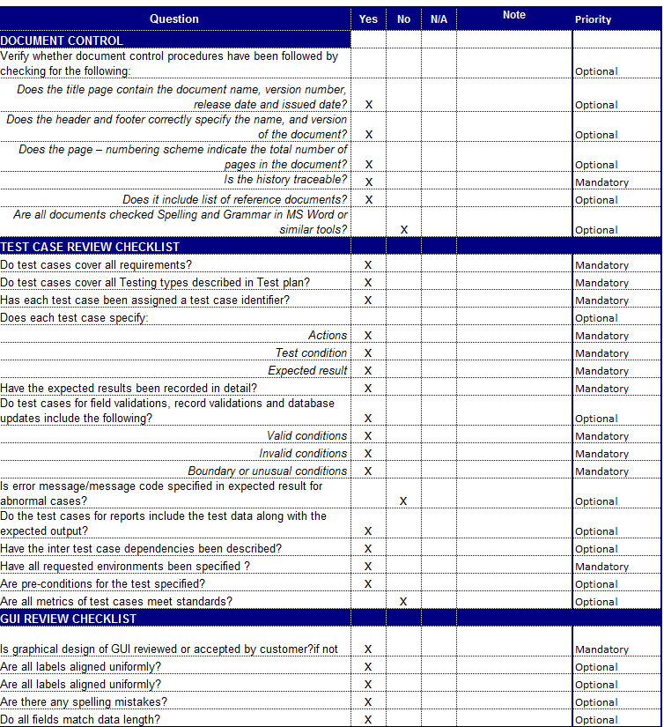
Test case review checklist -テストレビュー
49
57

Slide 56
5.1 Test Process -テストのプロセス
Tester execute test case follow phase:
Unit testing
Integration testing
System testing
1
Create Test Plan
2
7
3
4
5
6
Create Test Case
Review Test Case
Execute Test
Log Bug
Re-test
Create Test Report
50

Slide 57
5.1 Test Process -テストのプロセス
While executing test, tester detect, log bug and assign to appropriate developer.
1
Create Test Plan
2
7
3
4
5
6
Create Test Case
Review Test Case
Execute Test
Log Bug
Re-test
Create Test Report
51

Slide 58
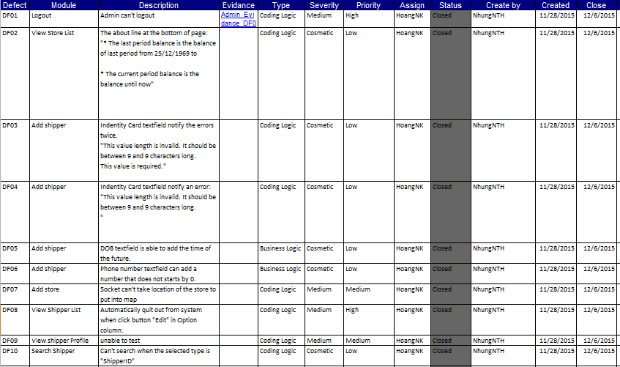
Log bug
52

Slide 59
5.1 Test Process -テストのプロセス
When Developer fixed bug, Tester re-test until bug was fixed successfully, then change defect of status to Closed.
1
Create Test Plan
2
7
3
4
5
6
Create Test Case
Review Test Case
Execute Test
Log Bug
Re-test
Create Test Report
53

Slide 60
5.1 Test Process -テストのプロセス
Tester has responsibility to write test report for each test phase. Finish testing phase, Test leader create Test report
1
Create Test Plan
2
7
3
4
5
6
Create Test Case
Review Test Case
Execute Test
Log Bug
Re-test
Create Test Report
54

Slide 61
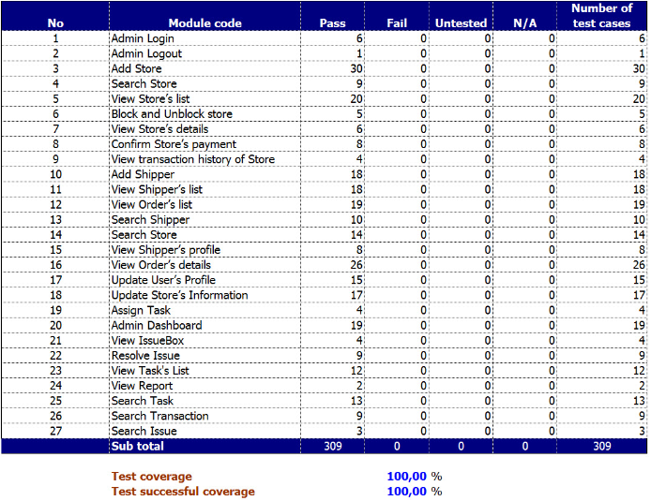
5.2 Test Report -テストのレポート
55

Slide 62
6. Project Result (プロジェクト結果)
Project Summary
Lesson Learn:
Apply all knowledge and skills that we have studied
Improve skills: teamwork, document writing, project management, communication, planning, resolving conflict.
Technical: AngularJS, NodeJS, Ionic Framework, PostgreSQL
Future Work:
Develop more functions: pay fee via banking service, stock management, API for store,…
Improve infrastructure and quality of product
56

Slide 63
7. Demo (デモ)
57

Slide 64
8. Q & A (質問と回答)
58

